Slide 1
Water Financial Plan and Rates
Council Briefings
June 2016

Slide 2
Current Financial Condition

Slide 3
Notes:
This graph will help explain our current financial situation.
Expenses have exceeded revenues for a number of years.
FY 2008 thru FY 2016 show ACTUAL expenses and revenues; FY 2017 is the projected BUDGET (actuals are always less than budget)
The surplus expected in FY 2017 is due to a one-time reimbursement and will restore our fund balance and fill our reserves.

Slide 4
Financial Planning Conceptual Model

Slide 5
Financial Plan Inputs
Operating budget, including debt service
Capital Improvement Program
Financial Policies

Slide 6
Projected Operating Expenses* – FY 2017 – FY 2021
* Includes Capital Outlay for things such as vehicles and equipment, but does not include costs related to capital projects.

Slide 7
CIP Investment Categories

Slide 8
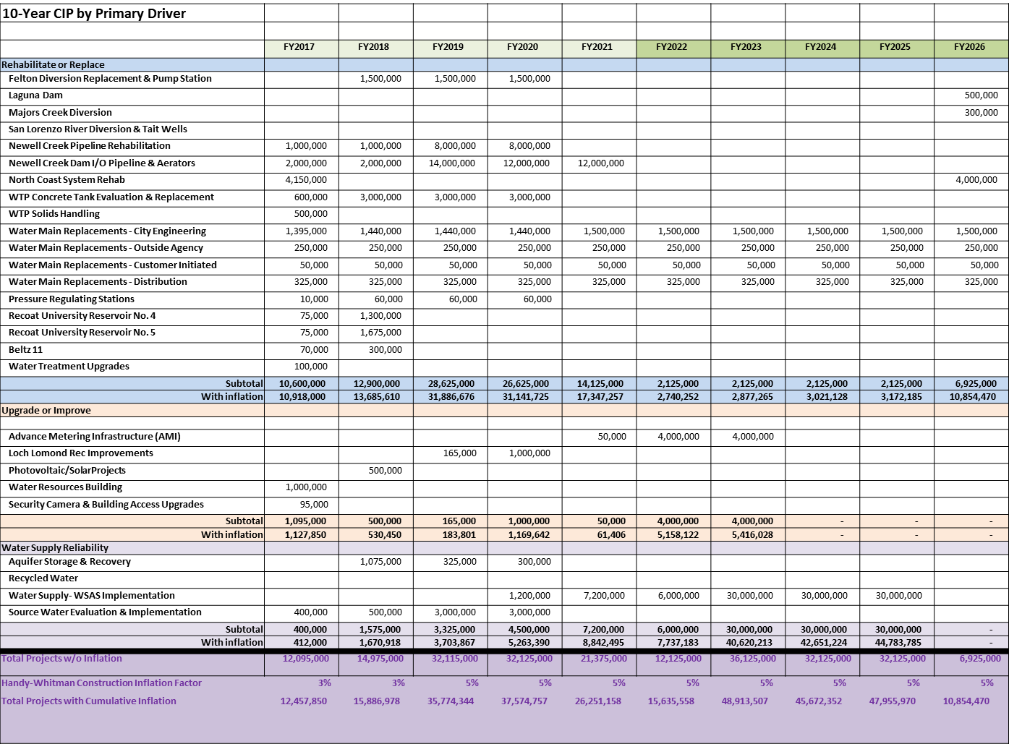

Slide 9
Utility Financial Policies
Build up and then maintain the Rate Stabilization Reserve at $10 million;
Maintain a Water Emergency Reserve Fund of $3 million;
Maintain an operating reserve equivalent to 180 days of operating expense; and
Establish a minimum Debt Service Coverage Ratio of 1.5 annual net revenues to annual debt service.

Slide 10
Current Status of Reserve Funds
Fund |  | Fund Balance (6-30-2015) | Funding Goal
711 | Water Operations & Maintenance | $4,321,718 | 90 Days Operating Cash $6.8M in 2017
713 | Water Rate Stabilization Reserve | $2,447,938 | $10,000,000
716 | Water 90-Day Operating Cash Reserve | $0 | 90 Days Operating Cash $6.8 M in 2017
717 | Water Emergency Reserve | $600,000 | $3,000,000

Slide 11
Financial Plan Output: FY 2017 – 2021 Revenue Requirements – the basis for setting rates
 | FY 2017 | FY 2018 | FY 2019 | FY 2020 | FY 2021
Infrastructure Reinvestment Fee Amount | $5,990,512 | $8,700,797 | $9,166,040 | $10,169,506 | $11,239,068
Rate Stabilization Reserve Amount | - | $3,342,224 | $3,342,224 | $3,342,224 | $3,342,224
O&M Revenue Requirement | $26,323,394 | $28,128,488 | $30,059,525 | $31,604,455 | $33,241,638
TOTAL | $32,313,906 | $40,171,529 | $42,567,809 | $45,116,205 | $47,822,950

Slide 12
Water Pricing Objectives
Composite Pricing Objectives for the City Council and Water Commission, March 2015
Revenue sufficiency | Revenue stability
2. Promotes efficiency | 6. Understandable by customers
3. Perceived to be fair by the public | 7. Promotes conservation
4. Affordable for essential uses | 8. Rate stability

Slide 13
Scenario vs. Pricing Objectives
Rankings | Pricing Objectives | Option 1A (90/10 – Com) | Option 1B (90/10 – Fixed) | Option 2A (60/40 – Com) | Option 2B (60/40 – Fixed)
Most Important | Revenue Sufficiency
Very Important | Promotes Efficiency
 | Revenue Stability
 | Perceived to be Fair to the Public
 | Affordability for Essential Use
 | Customer Understanding
 | Promotes Conservation
 | Rate Stability
Notes:
Includes the City Council and Water Commission Rankings

Slide 14
Rate Proposal Recommends 4 Changes:
Changes to the Rate Structure from 65% volume 35%fixed charges to 92% volume/8% fixed;
Changing the amount of revenue to be collected, resulting in rate increases;
Adding a new fee, the Infrastructure Reinvestment Fee to collect revenues to support planned capital spending; and
Increasing the Rate Stabilization Reserve from $2.4 million to $10 million to assure adequate revenue in light of the more volume based rate.

Slide 15
Proposed Rate Structure
Shift revenues away from fixed charge to commodity
Current: 36% fixed and 64% variable
Proposed: 8% fixed and 92% variable
Promotes water efficiency / conservation
Affordability for essential use
Perceived fair to the public
Rate Stabilization charge to enhance revenue stability
Begins in FY 2018
Consists of a uniform commodity charge of $1.00 per ccf

Slide 16
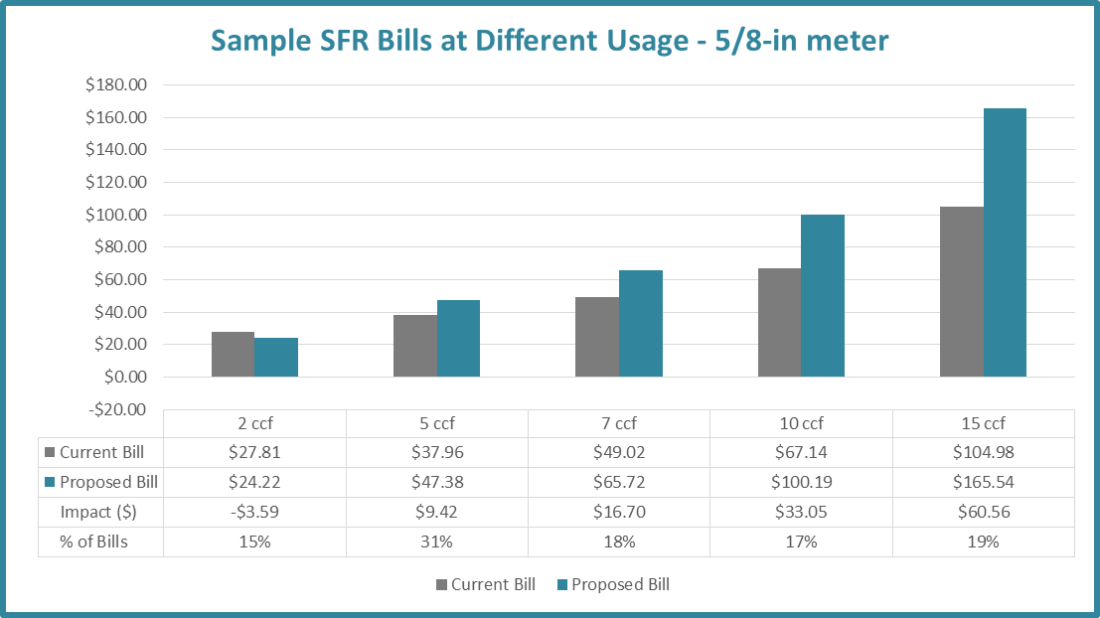
Customer Impact for Single Family
*Inside customer, includes elevation surcharge

Slide 17
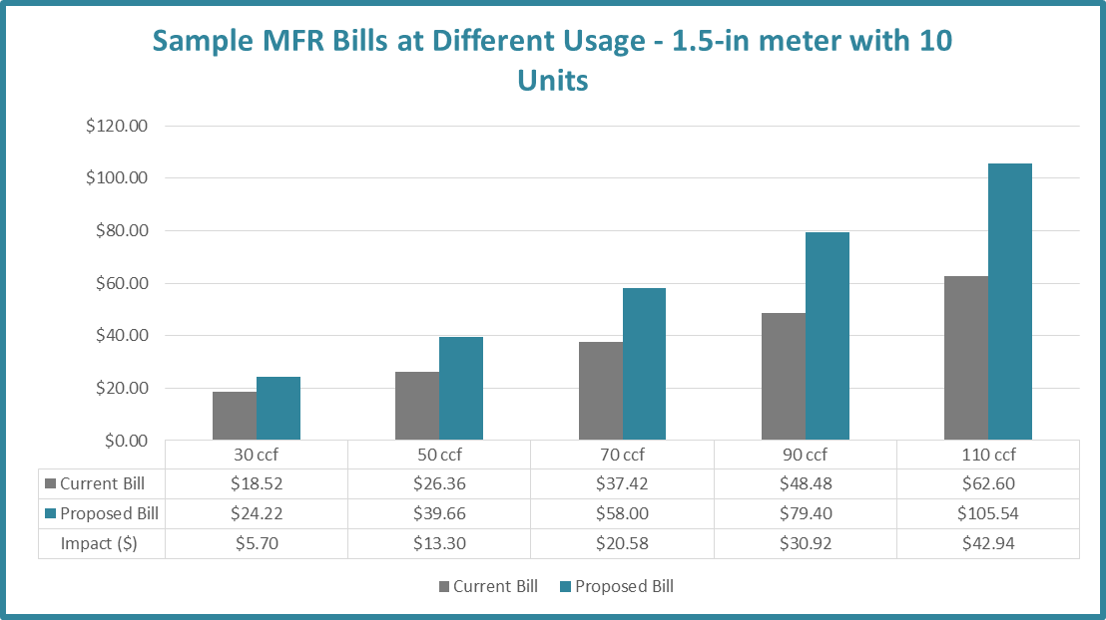
Customer Impact for Multi-Family 10 units and 1.5” meter

Slide 18
Assumptions and Provisions behind Proposed Water Rates
Assume water sales at 2.5 billion gallons per year.
Fixed fee will cover the cost of meter reading, meter maintenance, billing preparation and distribution, and customer service.
Volume-based user rates will collect the remaining operating revenues.

Slide 19
Infrastructure Reinvestment Fee
New Infrastructure Reinvestment Fee (IRF) used to collect revenues needed for “pay-as-you-go” capital investments and debt service for capital projects, and would be collected based on the volume charge.
Improves communication with customers about what water rates are paying for.

Slide 20
Justification for Tiered Rates Inside City
Commodity | Proposed Tier |  | Water Supply | Treatment | Delivery | Peaking | Conservation | IRF | Proposed FY2017 Rate ($/ccf)
SFR & MFR
Tier 1 | 0-5 |  | $1.76 | $0.46 | $2.17 | $1.35 | $0.00 | $1.55 | $7.30
Tier 2 | 6-7 |  | $1.76 | $0.46 | $2.17 | $2.03 | $0.00 | $2.32 | $8.75
Tier 3 | 8-9 |  | $1.76 | $0.46 | $2.17 | $2.51 | $0.51 | $2.86 | $10.28
Tier 4 | & Above |  | $1.76 | $0.46 | $2.17 | $3.37 | $1.03 | $3.85 | $12.65
COM
Uniform | Uniform |  | $1.76 | $0.46 | $2.17 | $1.98 | $0.20 | $2.27 | $8.84
UCSC
Uniform | Uniform |  | $1.76 | $0.46 | $2.17 | $2.10 | $0.21 | $2.40 | $9.11
North Coast AG
Uniform | Uniform |  | $1.76 | $0.00 | $1.55 |  | $0.27 | $3.05 | $6.63
Landscape
Tier 1 | 100% of TWB* |  | $1.76 | $0.46 | $2.17 | $2.46 | $0.00 | $2.82 | $9.68
Tier 2 | 150% of TWB |  | $1.76 | $0.46 | $2.17 | $3.69 | $1.07 | $4.22 | $13.38
Tier 3 | & Above |  | $1.76 | $0.46 | $2.17 | $3.74 | $2.14 | $4.27 | $14.54
Elevation Surcharge
Elevation |  | Uniform |  |  |  |  |  |  | $0.42

Slide 21
Rate Stabilization Reserve
Mitigate for the risks to revenue stability from a more volume based rate structure by adding a $1 per ccf surcharge in July 2017 to increase the Rate Stabilization Reserve from $2.3 million to a total of $10 million.
Use Rate Stabilization Reserve Funds to augment revenues during “normal” water years if the amount of water sold falls below 2.5 billion gallons.
Drought Cost Recovery Fee levied as a fixed charge used to stabilize revenues when water restrictions are needed due to inadequate supply.

Slide 22
What to do with any excess revenue produced by the $1 surcharge
If….
the minimum debt service coverage ratio target of 1.5 is being consistently met, and
reserves are fully funded, and
“pay-as-you-go” capital is being funded at an average over the previous 3 years of at least 25%;
Then either….
Reduce the size of additional rate increases, or
Consider
adjusting the amount of funding in the Emergency Reserve and the Rate Stabilization Reserve to be an established percent of the Operating budget (rather than a fixed dollar amount),
accelerating capital reinvestment in system infrastructure, or
increasing the proportion of capital that is being paid for with “pay-as-you-go” funding.

